Slide 1

Service Order – Partner Bank Details: OOALV + Adobe Form + CDS/AMDP/ADBC
CAPGEMINI : Case Study Presentation
Presented by :
Jhuma Roy
SAP ABAP Nov 20th Batch1 BLR

Slide 2
Introduction :-
What is Service Order?
A service order represents a customer request for maintenance, repair, or service activity.
It contains order header, customer, partner, and scheduling details.
Used in industries like utilities, telecom, manufacturing etc.
Motto of this case study.
To integrate multiple SAP technologies into one working solution.
To learn end‑to‑end development: OOALV → Navigation → PDF → HANA techniques.
To build a complete business scenario with real custom tables.
Service Order – Partner Bank Details: OOALV + Adobe Form + CDS/AMDP/ADBC ~ Jhuma Roy

Slide 3
Business Requirement :-
This case study replicates a real project scenario of viewing & printing service orders.
Display list of service orders with customer details
Allow hotspot click to open bank detail view
Provide “Print PDF” option
Support range selection (AUFNR, ERDAT)
Implement data retrieval using:
CDS
AMDP
ADBC
Use Screen 0100 + 0200 + Adobe Form
Service Order – Partner Bank Details: OOALV + Adobe Form + CDS/AMDP/ADBC ~ Jhuma Roy

Slide 4
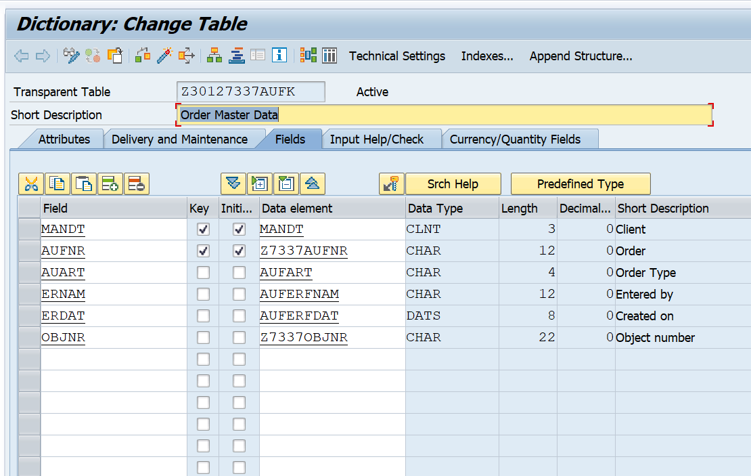
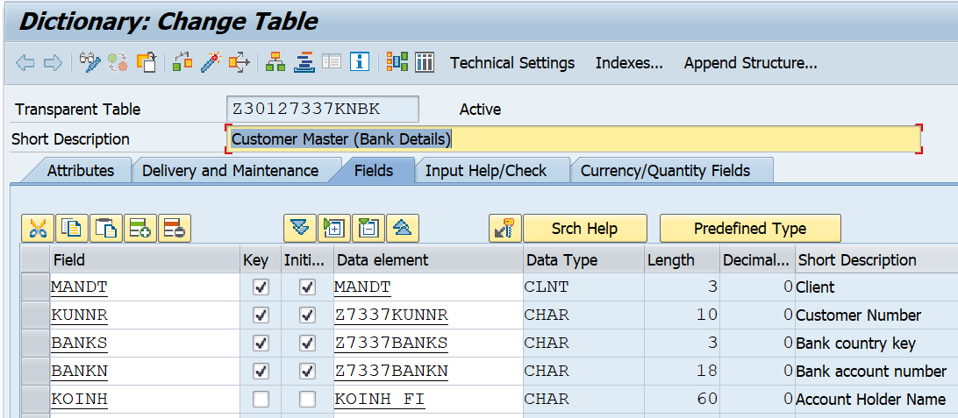
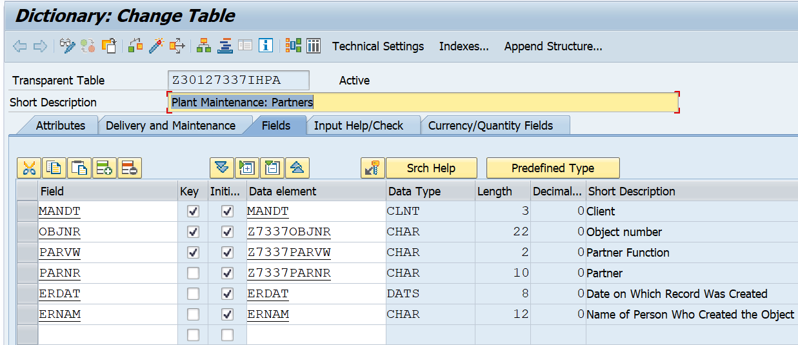
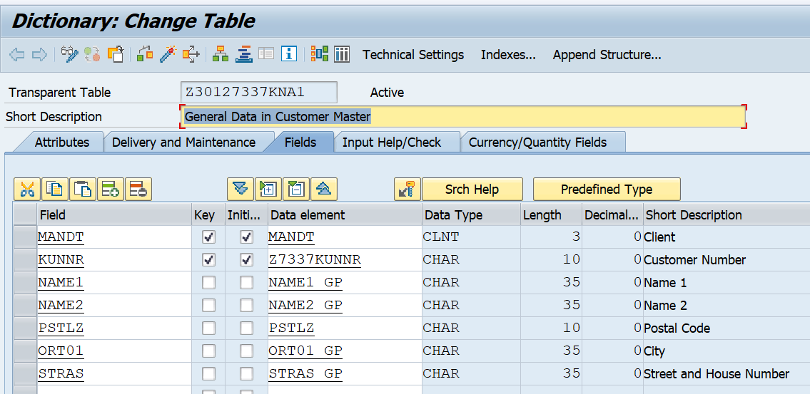
Methodology :-
1. Data Model (4 Customize-Tables) :
Tables Name
Z30127337AUFK – Order Master Data
Z30127337IHPA – Partner Details
Z30127337KNA1 – Customer Data
Z30127337KNBK – Bank Data
AUFK → IHPA → KNA1 → KNBK
Service Order – Partner Bank Details: OOALV + Adobe Form + CDS/AMDP/ADBC ~ Jhuma Roy

Slide 5
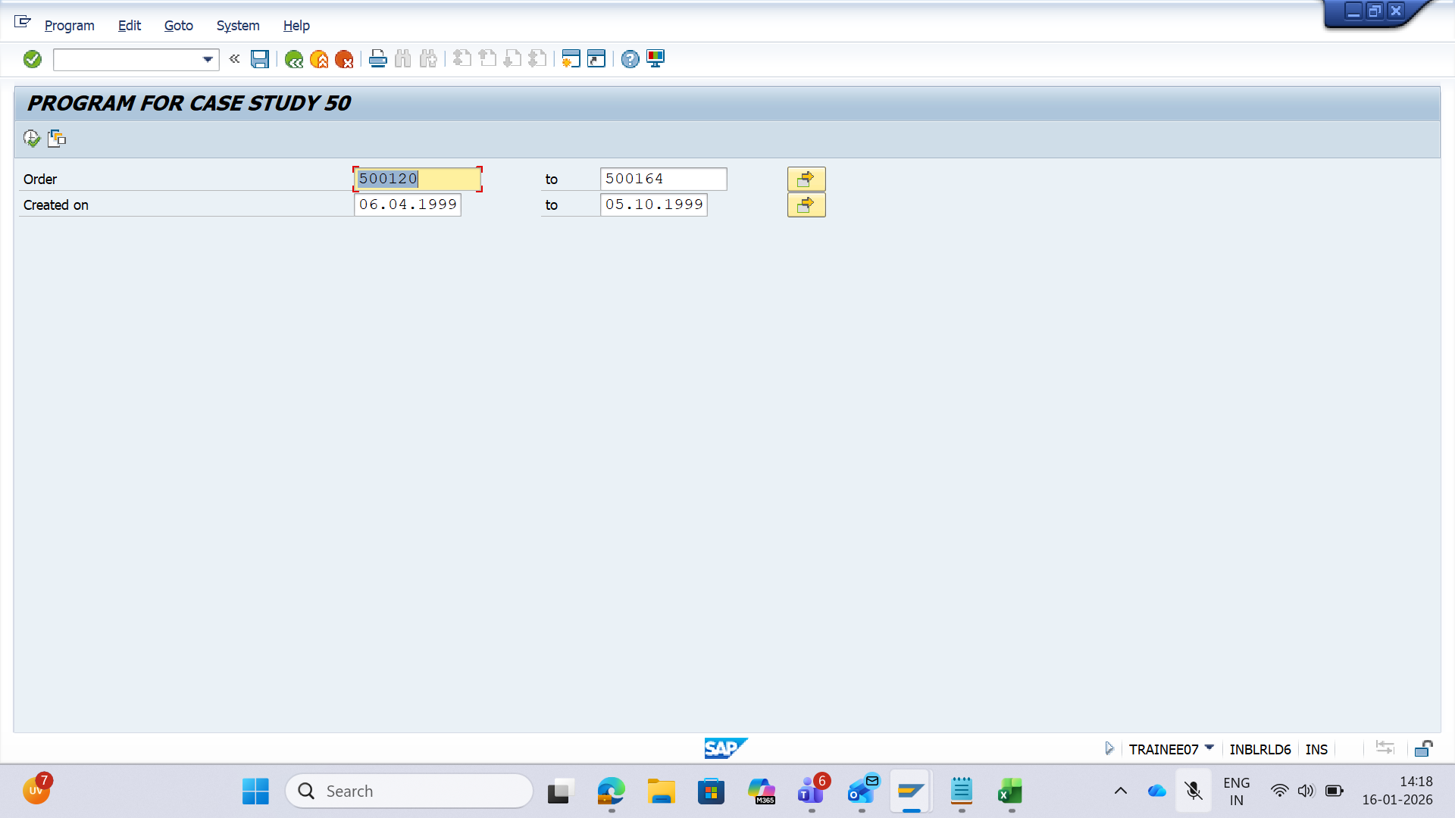
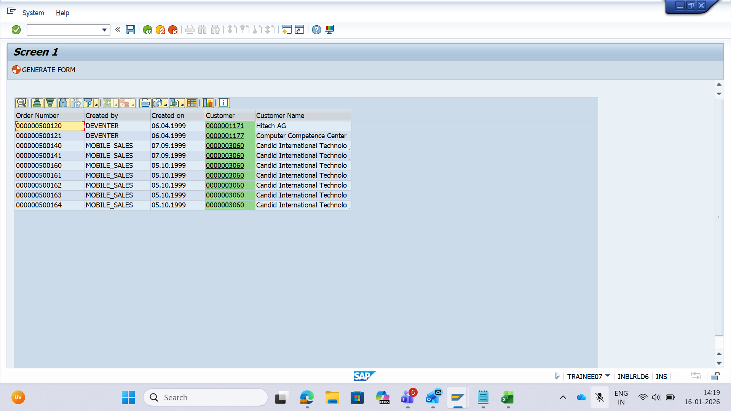
2.Selection Screen + OOALV :-
User enters AUFNR and ERDAT range
ALV on Screen 0100 shows header + customer info
KUNNR is clickable hotspot.
Print button available
Service Order – Partner Bank Details: OOALV + Adobe Form + CDS/AMDP/ADBC ~Jhuma Roy

Slide 6
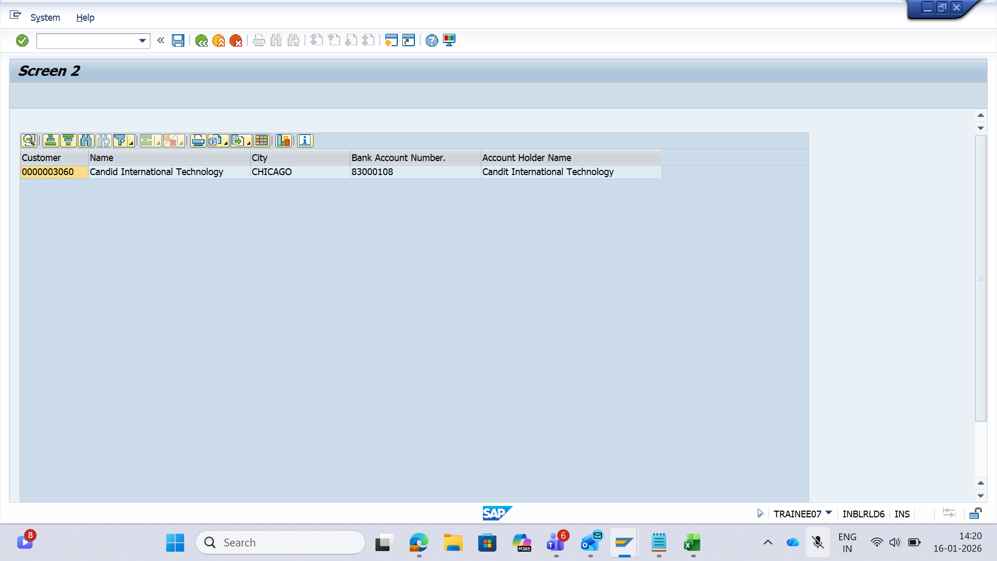
3.Hotspot Navigation + Detail OOALV
Click on AUFNR → second OOALV on Screen 0200
Detail ALV shows bank details
Service Order – Partner Bank Details: OOALV + Adobe Form + CDS/AMDP/ADBC ~ Jhuma Roy

Slide 7
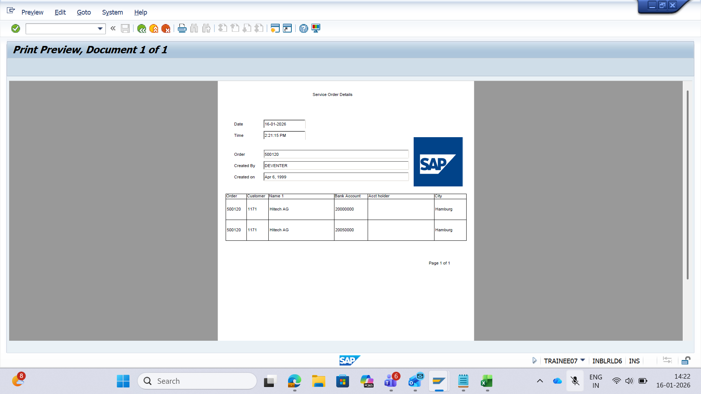
4.Adobe Form :
Adobe Form shows header +
customer + bank details
Called using
FP_JOB_OPEN / FP_JOB_CLOSE
Service Order – Partner Bank Details: OOALV + Adobe Form + CDS/AMDP/ADBC ~Jhuma Roy

Slide 8
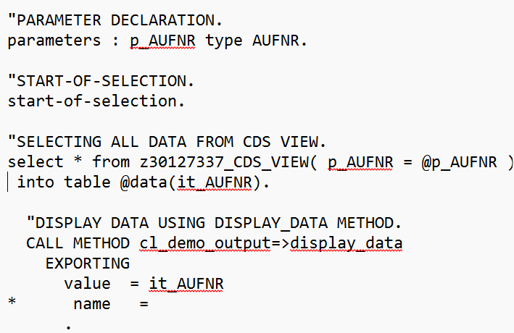
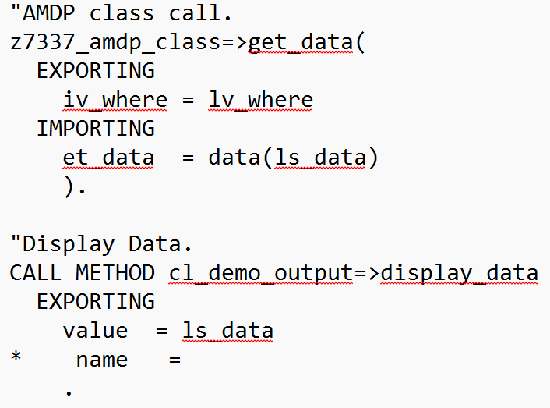
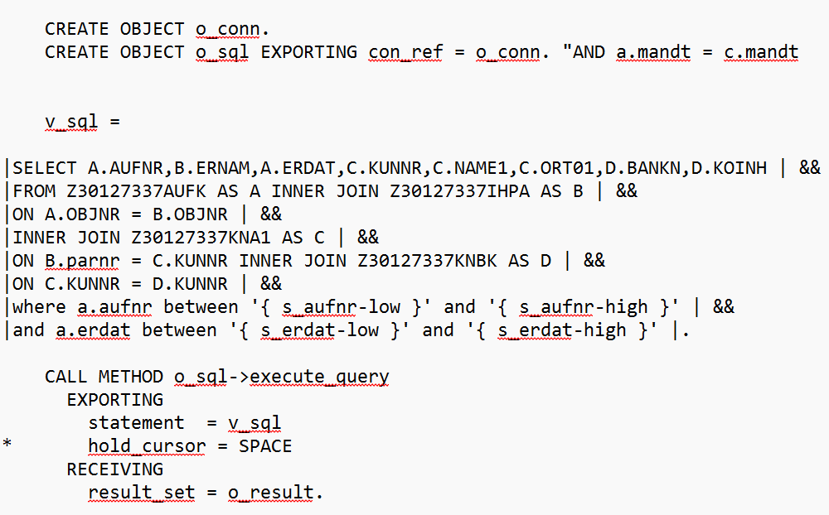
5.CDS/AMDP/ADBC Approaches:
CDS View Approach
Parameterized CDS
Simple, good for HANA pushdown
AMDP Approach
SQLScript
Handles ranges
Good for complex joins
ADBC Approach
Dynamic SQL
Used when CDS/AMDP not allowed
Service Order – Partner Bank Details: OOALV + Adobe Form + CDS/AMDP/ADBC ~ Jhuma Roy

Slide 9
Final Output Summary :-
Service Order – Partner Bank Details: OOALV + Adobe Form + CDS/AMDP/ADBC ~Jhuma Roy

Slide 10
Challenges + Solutions :-
Header OOALV Showing No Data
Challenge: There is no common field between Partner table and Customer Table . Solution: Adjust PARNR field of Partner Data and KUNNR field of Customer Data.
2. Hotspot Not Triggering
Challenge: KUNNR hotspot click was not firing. Solution: Set fieldcatalog-fieldname HOTSPOT = ‘X’ and implemented event handler.
3. Adobe Form Not Opening
Challenge: PDF was not generating (“No job started”). Solution: Added FP_JOB_OPEN and FP_JOB_CLOSE correctly.
4. ADBC SQL Errors
Challenge: String concatenation missing spaces causing SQL failures. Solution: Cleaned string templates and added mandatory spaces between clauses.
Service Order – Partner Bank Details: OOALV + Adobe Form + CDS/AMDP/ADBC ~Jhuma Roy

Slide 11
Key Learning and Conclusion :-
How ALV event handling works
How Adobe Form integrates with ABAP
Difference between CDS, AMDP, ADBC
Handling range parameters in advanced data retrieval
Complete end‑to‑end SAP development flow
Service Order – Partner Bank Details: OOALV + Adobe Form + CDS/AMDP/ADBC ~Jhuma Roy

Slide 12
THANK YOU FOR YOUR ATTENTION
I WELCOME YOUR QUESTIONS & INSIGHTS

